Slide 1
Lead Initiatives at Pennsylvania Department of Health
Julia Kaya
Epidemiology Research Associate
September 2026
Notes:
Introduce self.
Will provide an overview of the work that is being done in the DOH to prevent lead poisoning in children

Slide 2
Bureau of Family Health Lead initiatives
Childhood Lead Poisoning Prevention Program (CLPPP)
Lead Hazard Control Program (LHCP)
American Rescue Plan Act (ARPA) funding
Toll-Free Lead Information Hotline
Collaboration efforts with Children First and other stakeholders
Programs focus on jurisdiction with higher percentage of old housing and children with elevated blood lead level.
Notes:
3 bureaus are involved in lead poisoning prevention programs. BFH, BOE and BCHS
BFH has several programs and a dedicated section for lead poisoning prevention

Slide 3
Childhood Lead Poisoning Prevention Program (CLPPP)
Funded by the CDC
  About $600,000 per year
  6 grantees
The program aims to strengthen blood lead testing, reporting, and surveillance, linking exposed children to recommended services, and targeted population-based interventions.
Provides awareness and education to communities, healthcare providers and stakeholders.
Notes:
The program is funded by CDC, DOH has 6 CLPPP grantees. The program aims to strengthen blood lead testing, reporting, and surveillance, linking exposed children to recommended services, and targeted population-based interventions.
The program also provides awareness and education to communities, healthcare providers and stakeholders.

Slide 4
Lead Hazard Control and Healthy Home Program (LHCP & HH)
Funded by the US Department of Housing and Urban Development (HUD).
This funding supports:
  The reduction of lead-based paint and other home hazards.
  Training of lead certified workers to increase capacity.
PA DOH has applied for HUD 2025 Notice of Funding Opportunity to continue lead remediation within the commonwealth.
Notes:
PA DOH’s HUD funding for LHC expired in March 2025, the department has applied for the 2025 Notice of Funding Opportunity and expects to hear if awarded by late September, early Oct.

Slide 5
American Rescue Plan Act (ARPA)
ARPA funding is allocated to the Commonwealth for lead hazard control work and workforce development.
The Department is working with 18 grantees to conduct lead hazard control and training of lead certified workers.
Funding is available through December 2026
ARPA funds were allocated to the commonwealth through the advocacy efforts of Lead-Free Promise Project. $10 million was awarded to DOH with the intent of increasing the number of homes that are made lead-safe.
Notes:
ARPA funds were allocated to the state and through the advocacy efforts of Lead-Free Promise Project, $10 million was awarded to DOH with the intent of increasing the number of homes that are made lead-safe.
Using the ARPA funding the department has made many homes lead safe. Also, several lead professionals were trained and certified.

Slide 6
Environmental Lead Investigation (ELI)
Using ARPA funding PA DOH provides ELI services to eligible families who have a child with blood lead level of 3.5 μg/dL or higher.
Currently the department is working with 2 grantees to provide ELI services.
Services cover all counties in PA.
Grantees will provider ELI services through December 2026.
Notes:
All ARPA grants including ELI expire in December 2026.

Slide 7
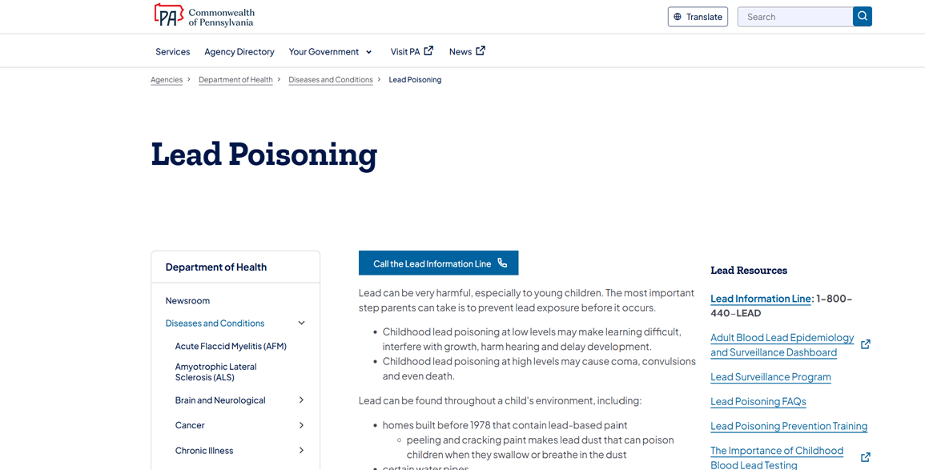
Toll-free Lead Information Hotline
The Department of Health maintains a toll-free lead information hotline (1-800-440-LEAD) to provide information about lead poisoning prevention, testing, follow-up, and local resources for assistance.
  Lead Poisoning | Department of Health | Commonwealth of Pennsylvania
Notes:
In addition, we have some educational resources available, including a lead information hotline. The Department receives calls from providers, parents/caretakers, and out of state organizations inquiring about lead prevention resources and information.
Our website contains information that links to other program areas and state agencies, including Lead based Paint Inspection and abatement contractors, and information on lead-safe renovations. As well as Lead Resources on the importance of lead testing, lead poisoning prevention trainings and links to CDC and US Environmental Protection Agency lead information.
Lead Brochures and Posters links can also be found.

Slide 8
Lead-Free Promise Project (LFPP)
Bureau of Family Health is collaborating with Children First to provide services related to:
        Lead poisoning education and awareness.
        Care coordination pilot program which aims to identify ways to address lack of coordinated services for children with elevated blood lead level.
        Strengthening the efforts of LFPP.
Notes:
As far as external partners, Since 2024 BFH has been funding Children First $500,000 per year to run the LFPP. Staff from BFH have been collaborating with children first to increase the number of children screened for lead poisoing in PA and to prepare resources for education.

Slide 9
Bureau of Epidemiology: Surveillance and Reporting
ALL blood lead results for children under 16 years of age must be reported to DOH.
The Pennsylvania National Electronic Disease Surveillance System (PA-NEDSS) collects and stores data on all reportable conditions.
Childhood Lead Surveillance report is published annually.
Lead Surveillance | Department of Health | Commonwealth of Pennsylvania
Notes:
One of the responsibilities of DOH is to manage the surveillance and reporting of blood lead levels. This is managed primarily by the Bureau of Epidemiology, and using a system called PA-NEDSS through which all reportable condition are collected and stored.
Labs are required to report all blood lead results, whether they are elevated or not, on children under 16 years old. Providers who use point of care machines in offices to test for lead are also required to report all results.
Data can be made available to counties and local health departments, either individually or aggregated as determined by data agreements. The Department also uses the data to create an annual report.
The report can be accesses here: Lead Surveillance | Department of Health | Commonwealth of Pennsylvania

Slide 10
Bureau of Community Health Systems
Operate the Department of Health State Health Centers located in 60 counties without a county or municipal health department.
Community Health Nurses provide education and referral information to families who have a child with elevated lead levels (>3.5 μg/dL).
Notes:
The BFH and other DOH partners involved with lead initiatives meet quarterly to stay abreast of the challenges and opportunities for improvement when it comes to case management of children with high BLL.

Slide 11
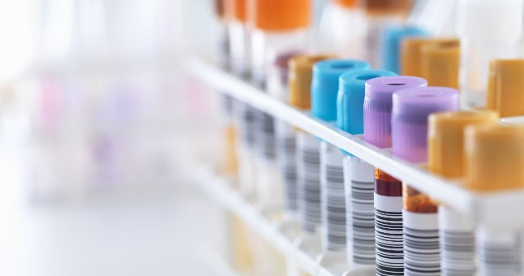
Universal Testing
The Pennsylvania Childhood Blood Lead Act (Act 150) passed in 2022.
Universal lead testing is essential in the prevention of childhood lead poisoning in the PA.
Senate Bill 850 requires the testing of all children in Commonwealth by two years of age so that prompt diagnosis and treatment, as well as the prevention of harm, are possible.
Notes:
The Pennsylvania Childhood Blood Lead Act was signed into law on November 3, 2022, and took effect on January 2, 2023, providing for blood lead assessment and testing of certain children and pregnant woman by healthcare providers. The Act establishes that health care providers shall consider possible lead exposure in an individual patient and/or pregnant woman by evaluating risk factors for lead exposures.
Universal lead testing is essential for increased lead testing and prevention of lead poisoning
Senate Bill 850 has been introduced during this legislative session. It would amend the 2022 Childhood Blood Lead Act to require, rather than encourage, the testing of all children in Commonwealth by two years of age so that prompt diagnosis and treatment, as well as the prevention of harm, are possible.

Slide 12

Challenges
PA has a higher percentage of homes built before 1978.
Lower testing rates.
Limited lead hazard control services in PA, especially rural areas.
Shortage of contractors for lead hazard control.
Federal and State funding limitations.
Notes:
PA has a higher percentage of home built before 1978, which increases the chance of getting lead poisoning for our children.
According to a preliminary data from childhood lead surveillance report only 34.94% of children under age 2 and 20.68% of children under age 6 were tested in 2023 in PA.
Some counties in PA don’t have Lead hazard control programs which limits the service.
The department is funding lead contractor training initiatives through ARPA funding (and HUD, if awarded) but still there is a lot to be done.

Slide 13
Many thanks to you all for working tirelessly to protect children from lead poisoning!
Notes:
DOH is grateful for the many community partnerships we have in doing this important work.

Slide 14
Contact Information
Bureau of Epidemiology, Childhood Lead
Julia Kaya| Epidemiology Research Associate
Phone: 717-547-3535
E-mail: jkaya@pa.gov
Childhood Lead Poisoning Prevention Program (CLPPP)
Shonda Mayo| Public Health Program Administrator
Phone: 717-772-2762
E-mail: shmayo@pa.gov
Lead Hazard Control Program and ARPA funding
Jolene Spacht | Public Health Program Administrator
Phone: 717-772-2762
E-mail: jspacht@pa.gov
Environmental Lead Investigation and ARPA Funding
Julia Liddick| Public Health Program Administrator
Phone: 717-772-2762
E-mail: julliddick@pa.gov
Notes:
Here is the contact information for the various Lead programs in BFH and the main contact for each program.

