Slide 1
Housekeeping Reminders
Please submit questions via the Zoom chat during the presentation.
For attendance, please type in your name and organization in the chat.
Attendees are muted upon entry. Click “Unmute” when you would like to speak. Please mute yourself after speaking.
The presentations are posted on Tomorrow’s HealthCare www.tomorrowshealthcare.org

Slide 2
2026 PCMH Perinatal Care in Family and Pediatric Offices
Sprint Session #4
September 15, 2026
Pittsburgh Regional Health Initiative

Slide 3
Continuing Education Information
In support of improving patient care, this activity has been planned and implemented by the University of Pittsburgh and The Jewish Healthcare Foundation. The University of Pittsburgh is jointly accredited by the Accreditation Council for Continuing Medical Education (ACCME) and the American Nurses Credentialing Center (ANCC), to provide continuing education for the healthcare team. 1.5 hours are approved for this course.
As a Jointly Accredited Organization, University of Pittsburgh is approved to offer social work continuing education by the Association of Social Work Boards (ASWB) Approved Continuing Education (ACE) program. Organizations, not individual courses, are approved under this program. State and provincial regulatory boards have the final authority to determine whether an individual course may be accepted for continuing education credit. University of Pittsburgh maintains responsibility for this course. Social workers completing this course receive 1.5 continuing education credits.

Slide 4
Disclosures
No members of the planning committee, speakers, presenters, authors, content reviewers and/or anyone else in a position to control the content of this education activity have relevant financial relationships with any entity producing, marketing, re-selling, or distributing health care goods or services, used on, or consumed by, patients
to disclose.
Notes:
No conflicts of interest

Slide 5
Disclaimer
The information presented at this Center for Continuing Education in Health Sciences program represents the views and opinions of the individual presenters, and does not constitute the opinion or endorsement of, or promotion by, the UPMC Center for Continuing Education in the Health Sciences, UPMC / University of Pittsburgh Medical Center or Affiliates and University of Pittsburgh School of Medicine. Reasonable efforts have been taken intending for educational subject matter to be presented in a balanced, unbiased fashion and in compliance with regulatory requirements. However, each program attendee must always use his/her own personal and professional judgment when considering further application of this information, particularly as it may relate to patient diagnostic or treatment decisions including, without limitation, FDA-approved uses and any off-label uses.

Slide 6
Learning Objectives
Describe examples of quality improvement interventions implemented by participating PCMHs during the 2026 Perinatal Sprint.
Discuss outcomes, lessons learned, and measures used to evaluate improvement efforts across participating practices.
Identify strategies for sustaining and scaling successful quality improvement interventions beyond the initial PDSA cycles.
Apply peer-to-peer learning to inform future quality improvement initiatives within participants' own practices.

Slide 7
2026 Perinatal Care in Family and Pediatric Offices
Sprint Recap
Robert Ferguson, MPH, Chief Policy Officer, Pittsburgh Regional Health Initiative

Slide 8
Perinatal #1: Interconception Care
Primary care is poised to fill gaps and address disparities in maternal health
Maternal screening at well child visits allows us to identify and address risk factors prior to the next pregnancy
Best Practice Recommendations:
  Initial assessment in the first 3 weeks postpartum
  Ask every person of childbearing potential if they have been pregnant in the last year.
  Obtain comprehensive obstetrical history and record of ongoing medical and mental health issues
  Educate staff members on trauma-informed care, cultural and racial humility

Slide 9
Perinatal #2: Vaccination Engagement
Kids Plus Pediatrics shared innovative practices to improve family vaccination engagement:
  Family Guide: Concierge-style website portal with accurate information for new families
  Baby Basics: Free, monthly virtual classes for new and expectant families
  The Village: Peer support group for patients and non-patients, facilitated by a doula
  Resource and Counseling Coordinator: Team role to help navigate resources, provide support
Communicate often and early with families to explain firm stance, provide accurate resources, and collectively come to decision

Slide 10
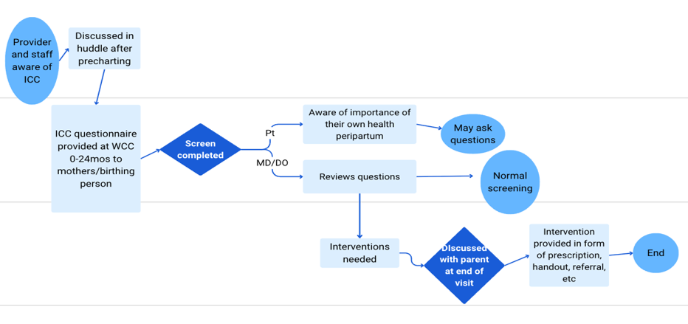
Perinatal #3: Maternal Mental Health
Postpartum depression is common, but screening helps promote the health of the birthing parent and the child
Guest speakers Moyer & Jones provided multiple tools & practical workflows to support PPD screening at well child visits (example)

Slide 11
2026 In-Person Wrap-Up Session Guidance
Robert Ferguson, MPH, Chief Policy Officer, Pittsburgh Regional Health Initiative

Slide 12
2026 PCMH LN In-Person Session – November 10th
Agenda:
Physical HealthChoices PCMH and PCMH-PNC Programs: History, Evolution, and Future Directions
Physical HealthChoices MCO Panel: PCMH Program Highlights
2026 PCMH Learning Network Sprint: Peer-to-Peer PDSA Poster Session
PCMH 2026 Sprint Accomplishments Recognition - Bronze, Silver, and Gold Designations
2027 PCMH Learning Network Goals, Sprint Topics, Structure and Next Steps
Knowledge Cafés to Prepare for 2027 Sprints

Slide 13
Poster Guidance
All PCMH Teams will present a poster that tells other PCMH Teams about their work. The purpose of these posters is to highlight your team's accomplishments throughout the year and disseminate best practices and lessons learned with other PCMH teams.
PCMHs are responsible for completing, printing, and transporting their own posters. Two templates are provided for your convenience: one large professional poster or a series of slides that can be printed with a typical office printer. You may also use your own design.
Poster Size and Submission Guidelines
One poster per PCMH Team per sprint is required. If you completed more than one PDSA cycle, you may choose one to describe here. If you completed one PDSA cycle in two sprints, please create two posters.
Please bring the final printed copy of your poster to the session on November 10th.
Instructions for locating the display area and push pins for displaying posters will be provided at check-in on November 10th.

Slide 14
PCMH Recognition
To celebrate the PCMHs' quality improvement work in the 2026 sprints, teams will be awarded PCMH designation levels that are defined below. All recognized PCMHs will receive a certificate.
Bronze: PCMHs that attended over half of sprint sessions throughout the year and submitted a PDSA each quarter
Silver: PCMHs that met the Bronze criteria and completed at least one round of a PDSA cycle with initial results
Gold: PCMHs that met the Bronze and Silver criteria and completed a second round of a PDSA cycle with a second round of results

Slide 15
2027 LN – Sprints and Knowledge Cafes
Trauma-Informed Behavioral Health Screening and Follow-up
with options to focus on:
pregnancy/postpartum depression (OB family medicine),
pediatric settings,
specific integrated care models with CBCM care managers or behavioral health consultants (e.g., Collaborative Care Management Model),
tobacco screening and cessation counseling,
inter-partner violence screening and follow-up,
how to use patient advisors for trauma-informed approaches, and/or
trauma-informed care training

Slide 16
2027 LN – Sprints and Knowledge Cafes
Community-Based Care Management (CBCM) Teams
with options to focus on
Pharmacists
CHWs
Care Managers
Peer Recovery Specialists
CBCM caseloads, or CBCM team retention, and
Patient communication and engagement skills

Slide 17
2027 LN – Sprints and Knowledge Cafes
Preventing Readmissions, Admissions, and Unnecessary ER Visits for Ambulatory-Sensitive Conditions
with options to focus on
10-day follow-ups
Collaborating with specialists, and
Leveraging P3N-certified HIO data and functions

Slide 18
2027 LN – Sprints and Knowledge Cafes
PCMH-PNC Sprint
Standardizing LOMNs and Family Care Plans

Slide 19
2026 PCMH LN In-Person Session – November 10th
Register for the In-Person Statewide Session
Tuesday, November 10th at 8:30 a.m. to 3:00 p.m. at the Harrisburg Hilton

Slide 20
PCMHs’ Sharing of PDSA Plans and Peer-to-Peer Learning

Slide 21
Discussion Questions
Briefly describe your PCMH's quality improvement goal and the intervention(s) your team implemented during the PDSA cycle.
What measures did your team track to assess the effectiveness of the intervention, and what did the data show?
What key lessons emerged from your team's experience implementing and evaluating the change?
What strategies is your PCMH considering to sustain and/or scale these improvements moving forward?

Slide 22
Next Steps, Wrap Up &
Session Evaluation
Lisa Boyd
Pittsburgh Regional Health Initiative

Slide 23
Next Steps from Today’s Session
Finish your PDSA plan by October 27th
Reach out with any questions or to request 1:1 support or TA
Register for the final in-person wrap-up session and supplemental sessions

Slide 24
2026 PCMH Learning Network
Final In-Person Session November 10th at 8:30 a.m. to 3:00 p.m.
Final In-Person Session
PCMHs share their completed PDSA cycles
LN recognizes PCMHs with greatest improvements
LN announces 2027 Sprints
PCMH Milestone: Complete at least 2 PDSA cycles and share at the in-person event*

Slide 25
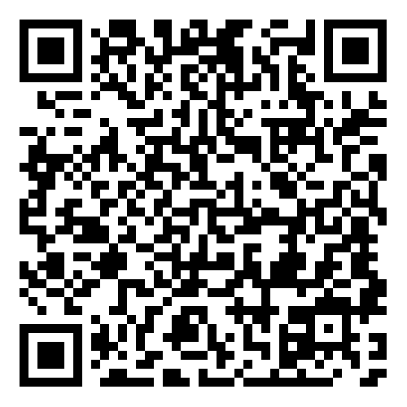
Upcoming Sessions
Oral Cancer Prevention and Early Detection
September 24, 2026
9:00 am – 10:00 am
Contraceptive Care: IUD Pain Management
October 29, 2026
9:00 am – 10:00 am
Statewide In-Person Wrap-Up Session (RSVP)
November 10, 2026
8:30 am – 3:00 pm

Slide 26



PCMH Online Community https://www.tomorrowshealthcare.org/
Access the session materials in “Learning Sessions”
Look for guides and tools in “Resources”
Find session dates and registration links under “Events”
Members of your PCMH’s multi-disciplinary learning team will receive log-ins

Slide 27
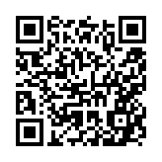
CEU Process
You will receive a follow up email with links to:
Complete the survey at: https://www.surveymonkey.com/r/CF7XLPM by Tuesday, September 22nd
Please be sure to designate which CEU credits you are requesting CME, CNE, Social Worker or Certificate of Attendance. If you already have an account with the UPMC Center for Continuing Education, please be sure the email you enter on the survey matches the UPMC CCE account email that you create.
The UPMC Center for Continuing Education will follow up with you via email after September 22nd with instructions on how to claim your credits.
  To claim your CEUS or certificate, you must create an account with UPMC CCE via this website https://cce.upmc.com.

Slide 28
Thank You!

