Slide 1
Pediatric Scoliosis:
Identification, Management & Referral
Joshua M. Pahys MD
Shriners Hospital for Children
Philadelphia, PA

Slide 2
Disclosures
DePuy Synthes: Consultant
NuVasive: Consultant
Zimmer Biomet: Consultant
No relevant disclosures for this presentation

Slide 3
Objectives
Learn how to clinically identify signs of spinal deformity
Learn when to refer to a pediatric spine specialist
Learn what other pathology can accompany spinal deformity

Slide 4
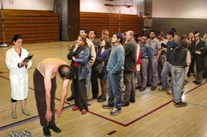
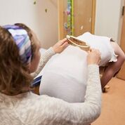
School screening/Pediatrician exam

Slide 5
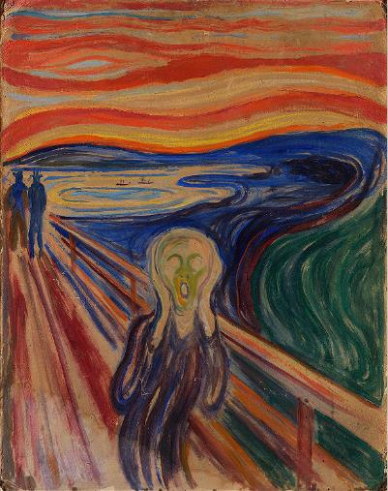
“What do you mean I have a hump???”

Slide 6
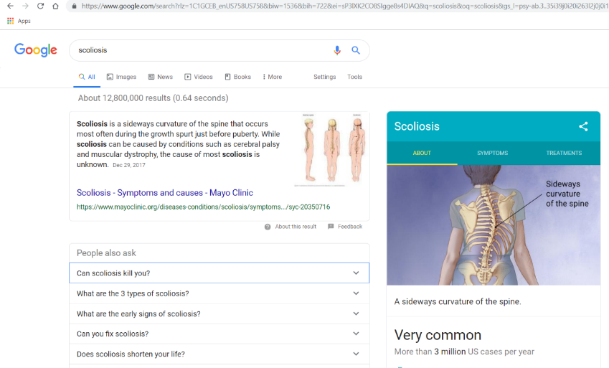
To the internet!!

Slide 7
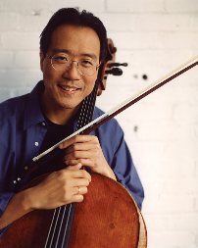
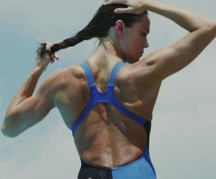
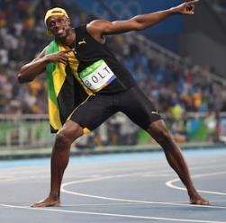
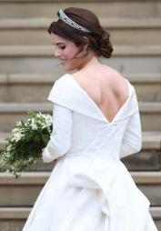
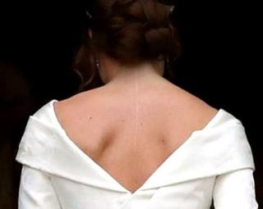

You’re in good company

Slide 8
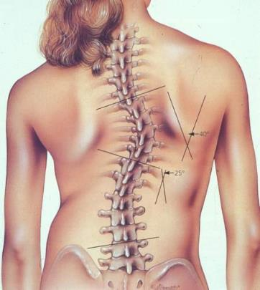
Idiopathic Scoliosis
Scoliosis is defined as a lateral curvature of the spine greater than 10 degrees
Idiopathic Scoliosis
  Infantile, Juvenile, Adolescent
  Physical Examination
  Imaging
  Treatment

Slide 9
Idiopathic Scoliosis
Infantile: 0-3 years
  Female to male: 3:2
  Left sided curves
  85% resolve spontaneously
Juvenile: 4-9
  Female to male: 2-4:1
  70% progress
Adolescent: >10
  F>M: 8-10:1
  Right sided curves
  Progression based on curve size and maturity

Slide 10
Adolescent Idiopathic Scoliosis:
Prevalence
>5 degrees 14% (F:M, 2 :1)
>10 degrees 2 to 3% (F:M, 5 to 1)
>20 degrees 0.3 to 0.5%
>30 degrees 0.2 to 0.3% (F:M, 10:1)

Slide 11
Proposed Etiologies
Remains unknown
Genetic
  Inheritance pattern unknown
  27% of daughters of women with scoliosis developed scoliosis
  Monozygotic twins display high rate of concordance (up to 70%)

Slide 12
Recommended Scoliosis Screening Protocol
US Preventative Services Task Force 2018
    Dunn J JAMA 2018
  Changed recommendation from “D” to “I”
    “Discourage” to “uncertain”
    “There is little evidence addressing harms of screening”

Slide 13
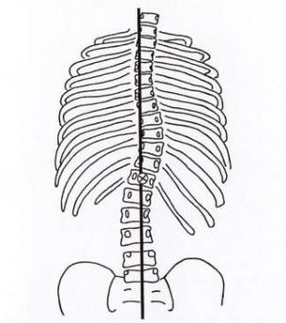
History
Age when first detected
Family history
Neurological symptoms
Back pain
Menses

Slide 14
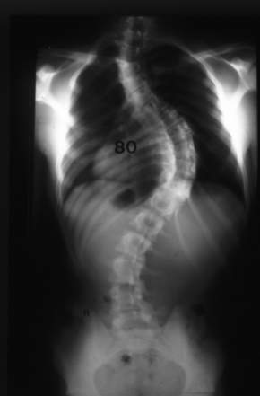
Physical Examination
Thorough neurological examination
  Asymmetric abdominal reflexes associated with intraspinal syrinx
Back Exam
  Shoulder heights
  Scapular prominence
  Trunk shift
  Lesions along back
  Pelvic obliquity
  Rib hump (Adam’s forward bend)

Slide 15
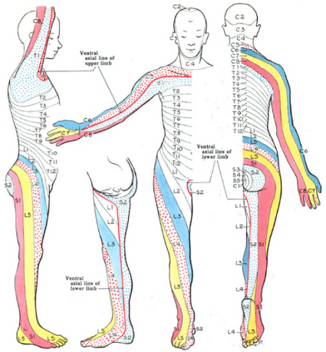
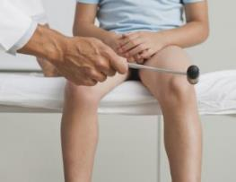
Neurologic Exam
Assess:
  Muscle strength
    Walk on toes/heels
    Squat down
  Sensation
  Reflexes

Slide 16
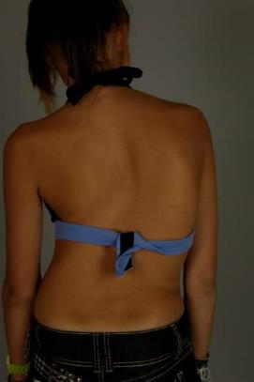
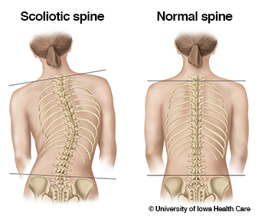
Clinical Examination
Evaluate shoulder balance

Slide 17
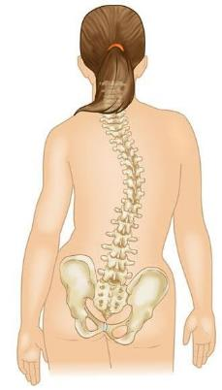
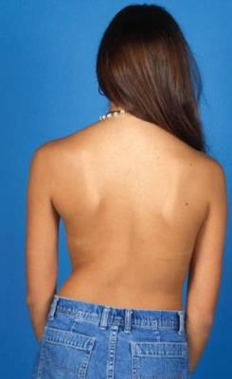
Clinical Examination
Assess for Trunk Shift

Slide 18
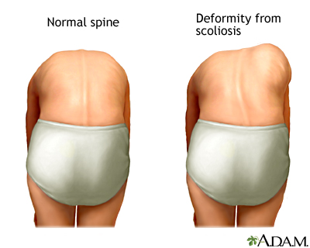
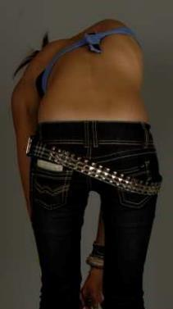
Clinical Examination
Adams Forward Bend Test

Slide 19
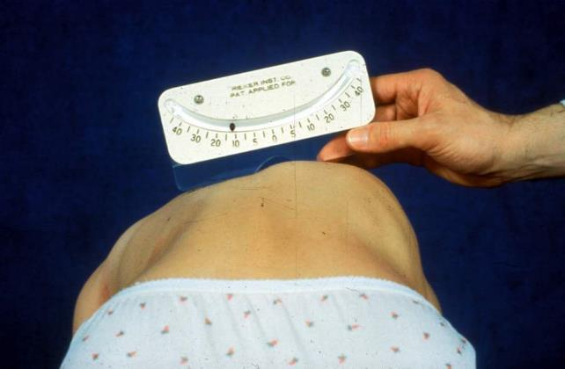
Scoliometer

Slide 20
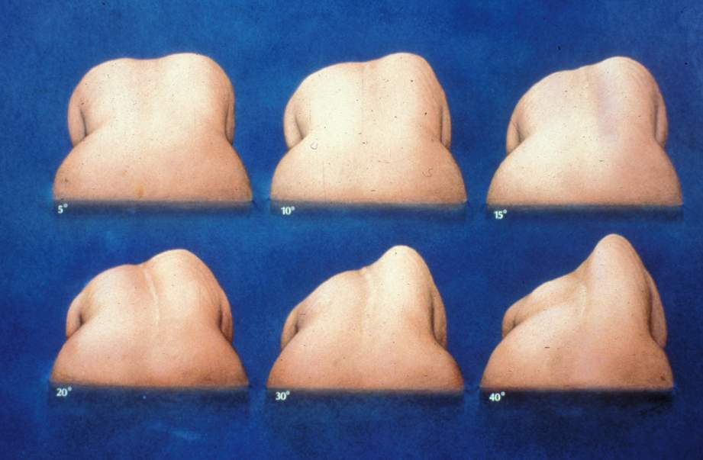

Slide 21
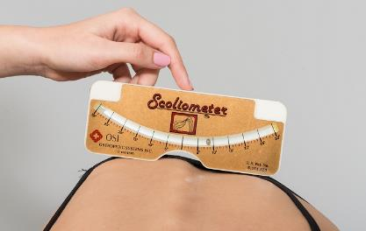
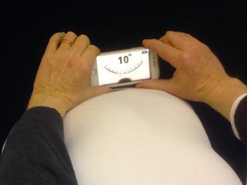
Scoliometer vs. Smartphone
=
Pearson correlation over 0.92 with Scoliometer vs. Smartphone measurements for Forward Bend Test with parents and surgeons
vanWest HM Eur Spine Journal 2021

Slide 22
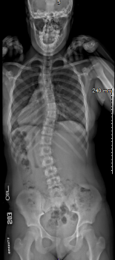
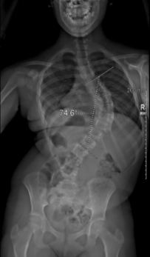
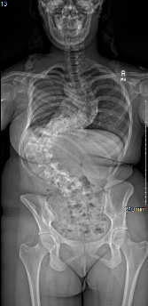

X-Ray Examination
Cobb Angle
  Assess curve location and size
  ~5$⁰$ measurement error
20⁰
75⁰
125⁰
20⁰

Slide 23
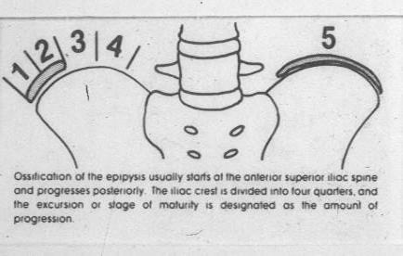

Natural History:
Percentage of Curves that Progress
Lonstein JE, Carlson JM. The prediction of curve progression in untreated idiopathic scoliosis during growth. J Bone Joint Surg Am. 1984;66:1061–1071.

Slide 24
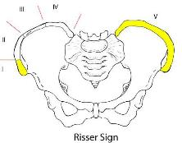
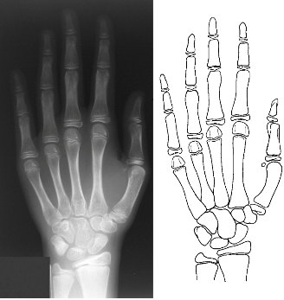
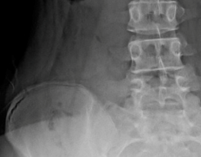
X-Ray Examination
Skeletal Maturity
Risser Sign
Sanders Digital Score
Sanders J JBJS 2008

Slide 25
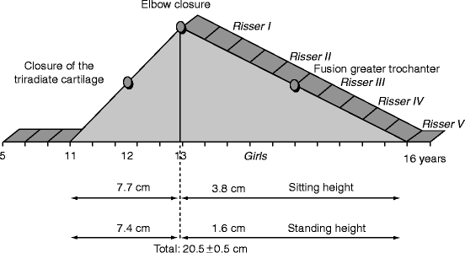

Growth in Adolescents
Girls
Boys
Menarche
Notes:
25

Slide 26
Treatment Guidelines:
Observation
Curves less than 20 degrees
  Immature: every 4-6 months
    Especially during growth spurts
  Mature: annually and then PRN if stable

Slide 27
Treatment: Conservative
Curves between 20-50 degrees
Progression greater than 5 degrees
Physical therapy has been postulated as an adjunctive treatment
Bracing
Weinstein S Spine 1986
Fan Y PLoS One 2021
Weinstein S NEJM 2013

Slide 28
Bracing in Adolescent Idiopathic Scoliosis
Results of the BrAIST Clinical Trial
Stuart L. Weinstein, MD, Lori A. Dolan, PhD,
and the BrAIST Study Group
Weinstein SL et al. NEJM. 2013; 369(16): 1512-21.

Slide 29
Randomized Analysis Results (Level I evidence)
Raw Success and Failure Rates by Assigned Treatment in the Randomized Population
Treatment | Success (%) | Failure (%) | Total
Brace | 38 (74.5) | 13 (25.4) | 51
Observed | 27 (41.5) | 38 (58.5) | 65
Total | 65 (56.0) | 51 (44.0) | 116
Odds Ratio 4.11
Relative Risk of Failure = 44%
Relative Risk Reduction (in failure rates) = 56%
  Weinstein SL et al. NEJM. 2013; 369(16): 1512-21

Slide 30
Summary of BrAIST
Weinstein SL et al. NEJM. 2013; 369(16): 1512-21
75% success rate with bracing
Number needed to treat = 3
Compliance is important
40% of observation had not failed at skeletal maturity

Slide 31
Scoliosis Specific Exercises
Park et al Eur J Phys Rehab Med 2018
  Meta analysis of 15 studies
    Schroth exercise more beneficial in curves 10⁰-30⁰ than those >30⁰

Slide 32
SRS Statement on Physiotherapy Scoliosis Specific Exercises (PSSE)
At the present time, there is no evidence supporting PSSE to be offered in substitution of bracing in treating progressive idiopathic scoliosis.
Definitive research lacking on PSSE
  New studies underway
  Collaboration with SRS and SOSORT

Slide 33
Recommended Scoliosis Screening Protocol
US Preventative Services Task Force 2018
    Dunn J JAMA 2018
  Changed recommendation from “D” to “I”
    “Discourage” to “uncertain”
    “There is little evidence addressing harms of screening”
BUT
  Did not address increased risks of surigical treatment of severe scoliosis Reames DL Spine 2011
  Untreated scoliosis requiring treatment in adulthood have dramatically higher operative complication and reoperation rates (30-50%) Charosky Spine 2012; Cho SK Spine 2012; Passias PG JBJS-A 2016

Slide 34
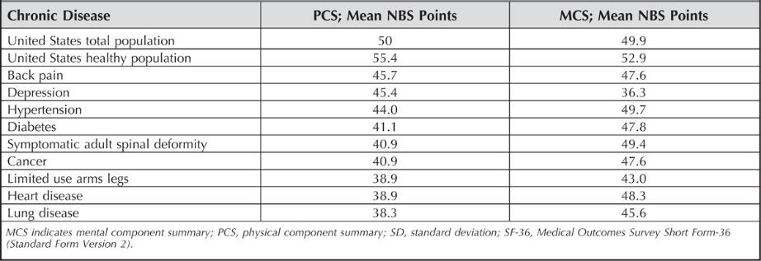
Untreated Progressive Adult Spinal Deformity
Bess S Spine 2016
The Health Impact of Symptomatic Adult Spinal Deformity: Comparison of Deformity Types to United States Population Norms and Chronic Diseases

Slide 35
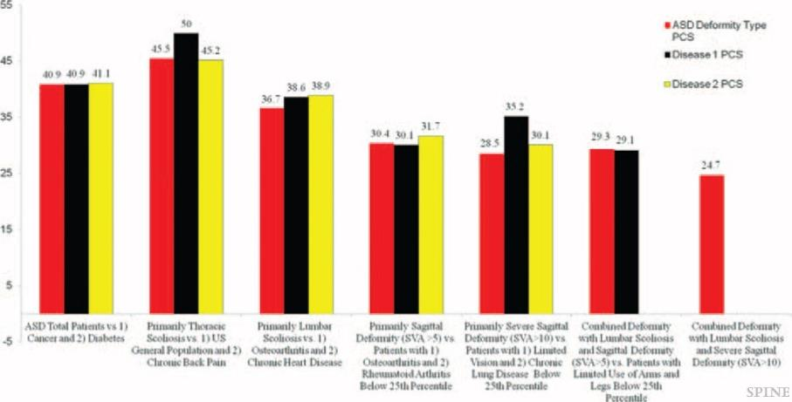
Untreated Progressive Adult Spinal Deformity

Slide 36
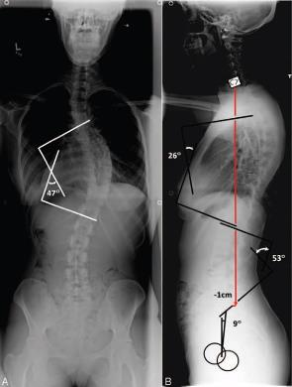
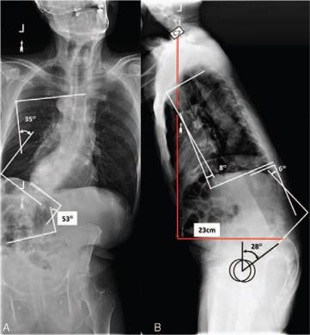
Untreated Progressive Adult Spinal Deformity
vs
Stable thoracic scoliosis:
Similar to healthy adults
Progressive lumbar scoliosis and sagittal imbalance:
Similar to vision impaired with limited use of arms/legs

Slide 37
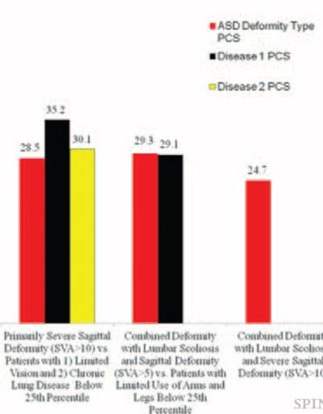
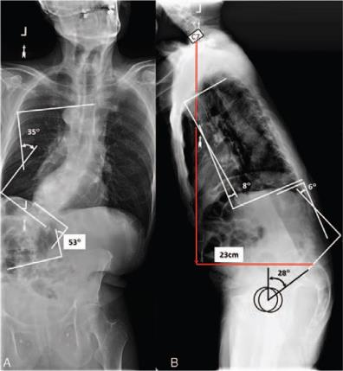
Untreated Progressive Adult Spinal Deformity
Worse functional scores than severe
chronic lung disease <25th %tile

Slide 38
Recommended Scoliosis Screening Protocol
US Preventative Services Task Force 2018
    Dunn J JAMA 2018
  Changed recommendation from “D” to “I”
    “Discourage” to “uncertain”
    “There is little evidence addressing harms of screening”
SRS, AAOS, POSNA, AAP Hresko JBJS-A 2016
  Forward Bend Test with Scoliometer
  Girls:
    Screen twice at 10 and 12 years old
  Boys:
    Screen at age 13-14 years old

Slide 39
Surgery
Curve magnitude greater than 50 degrees
Why: Natural history shows these curves will progress 1 degree/year on average
Clinically significant pulmonary compromise not seen until curves greater than 90 degrees (Johnston C Spine 2011)
Weinstein SL, Zavala DC, Ponseti IV. Idiopathic scoliosis: long-term follow-up and prognosis in untreated patients. J Bone Joint Surg. 1981;63:702–712.

Slide 40
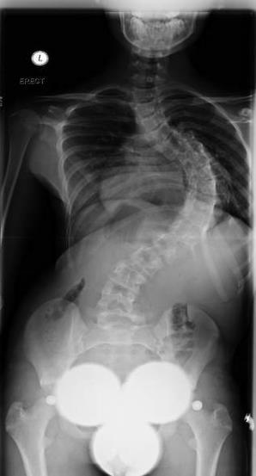
Surgical Planning
Goals
  Coronal and sagittal balance
  Curve correction in coronal, sagittal, and axial planes
  Level shoulders and hips
  Trunk over the pelvis
Balancing neurologic risk

Slide 41
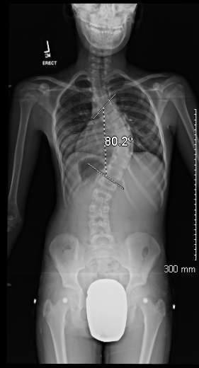
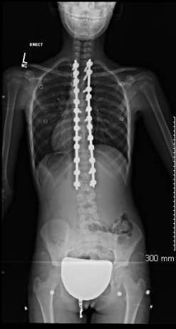
AIS Fusion
12 yo girl presented with progressive right thoracic curve
Underwent T2-L2 PSF

Slide 42
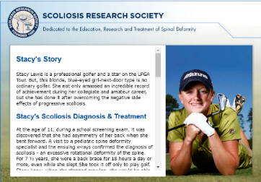
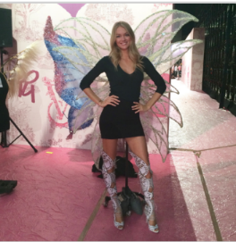
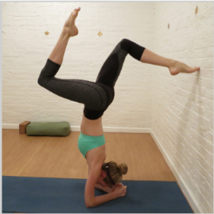
Fusion = The End….

Slide 43
Fusion Outcomes
Long term outcomes are favorable at 25-40 year followup
  Similar rates of back pain compared to matched controls (Danielsson Spine 2003)
  Physical function not significantly affected compared to matched controls (Danielsson Spine 2006)
Long term revision rates 5-10% (Takayama Spine 2009, Chang Spine 2010)

Slide 44
Trunk Motion Analysis Based on Lowest Instrumented Vertebra 2 Years After PSF
Average Trunk Flexion loss based on LIV:
  L1: 15% loss
  L2: 25% loss
  L3: 39% loss
  L4: 65% loss

Slide 45
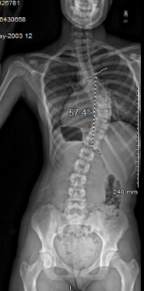
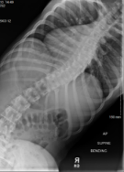
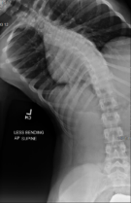
Vertebral Growth Modulation
Our Current Indications
Curve
  Magnitude 45-70º
    Flexible ≤ 35º
  Rotation ≤ 25º
  Kyphosis ≤ 40º
Adequate vertebral body size
Risser 0-2; Sanders 3-4
Premenarchal or menarche within 6 months

Slide 46
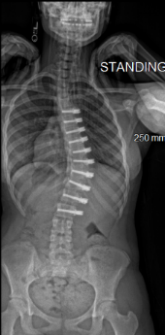
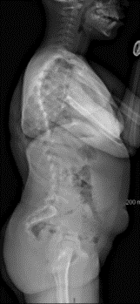
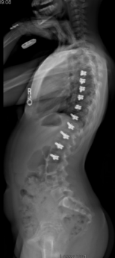


BF: 11 y/o female AIS Lenke 1AR
Risser 0 Sanders 4
Preop and 5 years postop

Slide 47
Back Pain
Acute and chronic pain more common in scoliosis patients (61% vs. 35% controls) at 50 year f/u (Weinstein SL JAMA 2003; Daielsson AJ Spine 2003)
  No difference in intensity/duration
  No correlation with severity/location of curve
Approximately 1% of patients with scoliosis require surgery specifically for back pain, similar incidence to the general population (Tones M. Spine 2006)

Slide 48
Evaluation, Diagnosis, and Treatment of Back Pain in Children and Adolescents
Joshua M. Pahys MD
Shriners Hospital for Children, Philadelphia, PA

Slide 49
Epidemiology
Incidence: 11-33% (Jeffries L Spine 2007)
  Increases with age
  “Nonorganic Pain” has increased substantially over the past decade
    Theories: sedentary lifestyle, obesity, increased backpack use
      Children with back, hip, knee, or ankle pain have a significantly higher BMI (Smith S Int J Obs 2014)
Review of 2,846 patients age 10-19 years (Miller R JPO 2013)
  Only 24% had a specific diagnosis
  61% failed to followup after 1-2 visits

Slide 50
Backpacks
Heavy backpacks relative to patient body weight and duration of use were associated with back pain
  Backpack weight >15-20% of a child’s body weight (Mackenzie W CORR 2003)
Pain typically not severe enough to warrant referral to Orthopaedics (Bo A Spine 2006)
Siambanes et al JPO 2004
  3500 students: backpack weight was predictor of pain
    Girls who walk to/from school highest risk
    Method of wear, age, socioeconomic status not significant

Slide 51
History
Onset
Duration
Frequency
Severity
Location
  Radiation to lower extremities
Concerning Complaints
  History of trauma
  Night pain
  Constant pain
  Weight loss
  Fever
  Pain >3 weeks
  Pain in children <10 years

Slide 52


Examination
Skin
  Examine for cutaneous lesions
    Possible indicator of intraspinal anomalies
    Sacral dimple
  >5 café au lait spots
    Neurofibromatosis

Slide 53



Examination
Midline/paraspinal palpation
  Evaluate for stepoff, focal pain, or masses
Forward bend test
  Evaluate for kyphosis/scoliosis
  Pain with extension
  Start up pain
Evaluate for hamstring tightness
  Normal angle <30 degrees

Slide 54

Neurologic Exam
Motor function L2-S1
  Hip flexion (L2)
  Knee extension (L3)
  Ankle dorsiflexion (L4)
  EHL (great toe) dorsiflexion (L5)
  Plantarflexion (S1)
  Can also ask patient to walk on toes/heels and squat
Sensation
  Light touch for lower extremity dermatomes

Slide 55



Neurologic Exam
Reflexes
  Knee/Achilles
  Assess for clonus
Abdominal Reflex
  Potential association with intraspinal anomalies
Straight leg raise
  Nerve root tension
  Seated or supine

Slide 56

Specific Exams
Stork Test:
  Trunk extension in single leg stance
  Ipsilateral or bilateral pain suggestive of spondylolysis
    Sensitivity and specificity low (Alquarni AM Phys Ther Sport 2015)

Slide 57

Specific Exams
FABER test
  Hip flexion, abduction, and external rotation (heel on contralateral knee)
  Possible indicator of sacroiliac pain/pathology if back pain is reproduced
  Groin pain more indicative of intra-articular hip patholgy

Slide 58
When to get an Xray
American College of Radiology (Booth TN J Am Coll Rad 2017)
  Imaging in children and adolescents may be delayed unless the patient has:
    Abnormal neurologic findings
    Night pain
    Radicular pain
    Pain > 4 weeks
  Lower threshold for imaging in children < 4 years and/or with constitutional symptoms

Slide 59
What Xray to get?
**Standing PA and lateral spine only**
Oblique views double radiation exposure and do not improve sensitivity to detect spondylolysis (Tufte JN Spine 2017)
Assess for:
  Alignment
  Disc space narrowing
  Endplate irregularities
  Vertebral scalloping
  Lytic lesions

Slide 60
Advanced Imaging
Considered when radiographs are inadequate to define pathology (neoplasm) and/or soft tissue pathology is suspected (disc herniation, infection, etc)
MRI
  No radiation, but may require sedation
  May fail to detect spondylolysis, but improved with modern sequences
CT
  More helpful in identifying spondylolysis (specifically SPECT scan)
  Markedly increased radiation exposure

Slide 61

Back pain imaging algorithm
Feldman et al JPO 2006
  High diagnostic sensitivity and specificity for detecting abnormalities
  No cause for symptoms found in 64% of patients with single report of LBP
    Diagnosed with nonspecific LBP and treated nonoperatively

Slide 62
Lab Work
Consider for patients < 5 years with prolonged back pain and/or constitutional symptoms/night pain
  CBC, ESR, CRP
Infection
  ESR >20; CRP >1-2mg/dL
    95% sensitivity for osteomyelitis, but 60% specificity
Lymphoma
Leukemia
Inflammatory disorders
  HLA-B27 strongly associated with seronegative spondyloarthropathy
  High false positive rate
  Should be reserved for highly suspicious patients
    Morning stiffness, night pain, sacroiliac pain

Slide 63
Differential Diagnoses
Nonspecific Low Back Pain
Spondylolysis/Spondylolisthesis
Scheuermann Kyphosis
Lumbar Disc Herniation
Spondylodiscitis
Neoplasm

Slide 64
Nonspecific Low Back Pain
2/3 of patients with LBP have no demonstrable cause of organic pathology even after complete clinical evaluation and imaging (Beck NA JBJS 2013)
Musculo-ligamentous strain
Overuse syndromes
Poor posture
Deconditioning

Slide 65
Nonspecific Low Back Pain
Reassurance of lack of “red flags”
  No radiculopathy and/or neurologic deficit
  Present <3-4 weeks
  No trauma
Prescribe daily home exercise routine and/or physical therapy (1-2x/week for 4-6 weeks)
  **Stress adherence to daily exercises**
  Core strengthening/stabilization
  Planks (make it a family competition, goal 3 minutes!)
  Modalities

Slide 66


Core Strengthening Daily Home Exercises

Slide 67
Nonspecific Low Back Pain
Be on the lookout for:
  Depression
  Conversion disorder
  Amplified pain syndrome
Consider Behavioral Health consultation
Prescription of opioids and/or prolonged NSAIDs discouraged (Frosch M Children 2022)

Slide 68
Outcomes into Adulthood
Pregnancy likely no effect
  Betz at al 355 patients with scoliosis
    No difference in curve progression
    No increased risk of pregnancy related complications
  Swany et al (2019)
    Slight increase in C-section rates if fused to L3 or below
Betz RR, Bunnell WP, Lambrecht-Mulier E, MacEwen GD. Scoliosis
and pregnancy. J Bone Joint Surg. 1987;69:90–96.

Slide 69
Key Points
Adolescent Idiopathic Scoliosis
Curve <20⁰: observation
Curve 20-50⁰: Bracing
  Scoliosis specific exercises possible adjunct
Curve >50⁰:
  Avg. 1⁰ per year progression into adulthood
  Consider surgery if progressive

Slide 70
Infantile Scoliosis
Birth to 3 years old
  First, think congenital scoliosis
  Rib Vertebral Angle Difference
    Greater than 20° - high risk of progression
  80% are self limited
  If curve >35° or RVAD>20° → likely progressive, recommend casting/bracing
Notes:
70

Slide 71
Infantile Scoliosis
Treatment Options
Bracing
  Questionable efficacy
  Compliance
Casting
  Serial casts applied at 2-3 month intervals
  Ideal in children less than 2 years of age

Slide 72



Infantile Idiopathic Scoliosis
Casting
22 months old
Mehta Body Cast
3.5 years old

Slide 73


Casting Efficacy

Slide 74
Casting efficacy
Iorio JPO 2017
  Improvement in curve if casting initiated before 1.8 years
  Curves improved if in cast RVAD <20⁰
Stasikelis JPO 2018
  26 IIS pts curves 50 ⁰ -106⁰
  35% had resolution of deformity
  30% maintained deformity within 15⁰ of initial curve
  10% underwent growth friendly surgery after mean delay of 71 months (range 18-100 months)

Slide 75

Treatment Options for the Immature Spine
Growth Friendly
  Skeletally immature patients (less than 10 years of age)
  Allows growth of spine and pulmonary function
  Early fusion leads to short trunk and severe restrictive lung disease
Karol L CORR 2011; 469(5): 1323-9

Slide 76


CD: 7y/o female JIS
Ht: 128cm
90⁰
65⁰
Notes:
3317153

Slide 77





3 months postop
T3-L3 bilateral MCGR

Slide 78


15 months postop
T3-L3 bilateral MCGR - 20mm expansion

Slide 79
Early Onset Scoliosis (0-9 years)
Key Points
Infantile Idiopathic Scoliosis (0-3 years)
  80% self limited
  Risk of progression if curve >35°
  Early treatment with casting (<18 months) increases success rates
  Refer to spine specialist by one year if still present
Juvenile Idiopathic Scoliosis (4-9 years)
  Higher rates of progression
  Bracing treatment for curves 25-50+ degrees
  Growth friendly surgery for severe progressive curves
Consider MRI to evaluate for intraspinal anomalies (13-20% incidence) Pahys J Spine 2011
Notes:
79

Slide 80

Congenital Scoliosis
Caused by an error in early vertebral column formation
Curve progression occurs from unbalanced growth of the spine

Slide 81


Categories of Congenital Scoliosis
Formation
Segmentation

Slide 82
Natural History
Curve progression predicted by type of anomaly and location
  Lumbosacral anomalies portend worse prognosis
Bracing has no effect on primary curve, but may prevent compensatory curves
Surgery reserved for curve progression

Slide 83

Associated Conditions
Skin tags
Sacaral Dimple
Hairy patch
Hedequist and Emans JAAOS 2004

Slide 84

Associated Conditions
Spine, genitourinary, musculoskeletal, and cardiovascular systems all develop at the same time
Up to 61% of patients may have associated anomalies
Check Echo, RBUS, MRI spine
Hedequist and Emans JAAOS 2004

Slide 85
Congenital Scoliosis
Key Points
Caused by an error in early vertebral column formation
Assess for other anomalies
  Echo
  Renal Ultrasound
  MRI spine

Slide 86

Torticollis, SCM anatomy
Torticollis “torus”=twisted “collum”=neck
Abnormal posturing of head and neck
Sternocleidomastoid
  Sternum/clavicle → mastoid
  Contraction: lateral bend to ipsilateral side and rotates chin toward the opposite shoulder
  Spinal accessory nerve (cranial nerve XI)

Slide 87




Torticollis: Broad Differential Diagnosis
Congenital muscular most common 80%
Bony anomalies
  Condyles, hypoplasia
Neurologic
  Chiari, tumor
Acquired
  Trauma, Infection (Grisel’s)
Ocular
Sandifer Syndrome: GERD + torticollis
Vestibular
Notes:
Idiopathic spasmodic torti- mean age 40, 9/100000

Slide 88
Torticollis evaluation
History
  Traumatic birth, breech position
  Recent infection, ENT surgery
  Reflux symptoms
Physical Exam
  Cervical ROM, stability
  Palpation SCM
  Visual field tracking
  Gross neurological exam
Workup
  Ultrasound: CMT
  Cervical Xray: traumatic birth, unresponsive to PT
  CT: concern for osseous etiology, atlantoaxial subluxation
  MRI: neurologic symptoms

Slide 89

Congenital muscular torticollis (CMT)
80% of all torticollis patients
Three types
  Type 1: Palpable mass
  Type 2: SCM tightness
  Type 3: No mass/tightness
History of difficult birth in 30-60%
    Intrauterine malposition, birth trauma
Etiology: peri-natal compartment syndrome

Slide 90

Congenital muscular torticollis (CMT)
  80% with craniofacial asymmetries
    Plagiocephaly, ipsilateral facial flattening, downward displacement of eye and mouth
  20-30% with congenital hip dysplasia
  Ultrasound: imaging modality of choice

Slide 91

Congenital Muscular Torticollis Treatment
PT stretching
  95% resolve with conservative treatment
Surgery = SCM release
  Indications
    >6 months PT with residual head tilt, restricted ROM
SCM release
  Unipolar
  Bipolar
    Typically reserved for severe or recurrent
  Z-plasty
  Good results with all in literature (Lee et al, 2012)
Tomczak J Child Neurol 2013

Slide 92

Timing of Surgical Treatment in Torticollis
Treat early
  Facial asymmetry
    Orbits: full growth by age 5-7
  Seo SJ et al J CF Surg, 2016
    Before age 10
    Horizontal facial asymmetry improved if treated before age 5
  Lee et al, JBJS 2012
    80 patients
    Best if release done before age 5
Seo SJ et al, J Craniofac Surg 2016;27:64-9
Lee et al, JBJS-A 2012;94:e93.
Notes:
Facial bones grow until age 18
Upper orbits until age 5,

Slide 93


Ocular Torticollis
4% ocular
  Vertical strabismus most common
  nystagmus
Superior oblique palsy (CN IV)
  Child adopts head posture to maintain binocular vision
Treatment
  Botox
  Surgery: strengthen superior oblique muscle and weaken inferior oblique
Akbari MR et al, J Curr Ophthalmol 2013;27:4-11
Ballock RT & Song KM, JPO 1996;16:500-4
Notes:
Cranial nerve 4 inversion depression and abduction
Head moves in opposite direction
Prefer vision on samd side as palsy

Slide 94


Osseous torticollis
Bony Defects
  Klippel-Feil syndrome
  Congenital C1-C2 misarticulations
Treatment
  Observation, avoid contact sports
  Surgical fusion +/- decompression

Slide 95

Osseous torticollis
Atlantoaxial subluxation/dislocation
  Congenital
    Down syndrome
  Traumatic
  Grisel’s disease
    Atlantoaxial rotatory displacement from infection or head/neck surgery
Imaging
  C spine xrays
  Dynamic head CT is gold standard
Treatment
  <1 wk: soft collar, anagesia, +/- Abx
  >1 wk: cervical traction and immobilization
  >3months/deficits: PSF C1-C2

Slide 96

Neurologic torticollis
Posterior fossa or Cervical spine tumors
Syringomyelia
Arnold-chiari malformations
Signs of increased intracranial pressure
  HA, vomiting, CN VI palsy

Slide 97
Torticollis Take Away
Congenital muscular torticollis in 80%, benign
  95% resolve with PT
  If surgery perform <5 years of age to avoid facial asymmetry
Good history and physical to rule out nonmuscular torticollis
  CN IV palsy: eye tracking
  Osseous etiology: cervical ROM, response to PT, recent infection/ENT surgery
  Neurologic etiology: neurologic findings

Slide 98
Pediatric Spine Key Take Aways
Assess spine as part of clinical exam
  Early detection is key!
Look for other anomalies in early onset
  Skin lesions, sacral dimpling, hairy patch
  Cardiac/Renal in congenital scoliosis
Forward bend test for adolescents
Torticollis – most will resolve with PT
When in doubt, give us a call anytime☺

Slide 99
Thank you!

